Slide 1


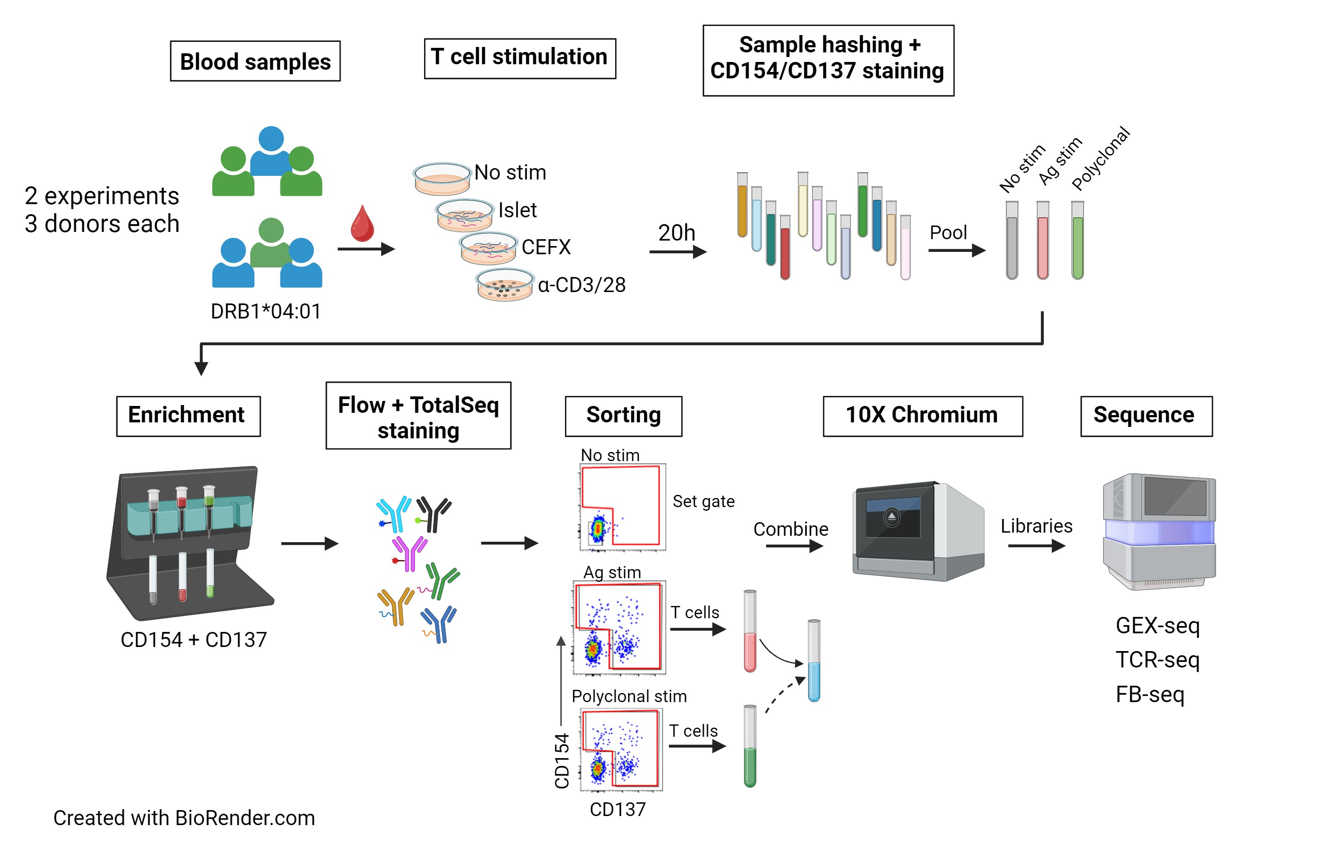
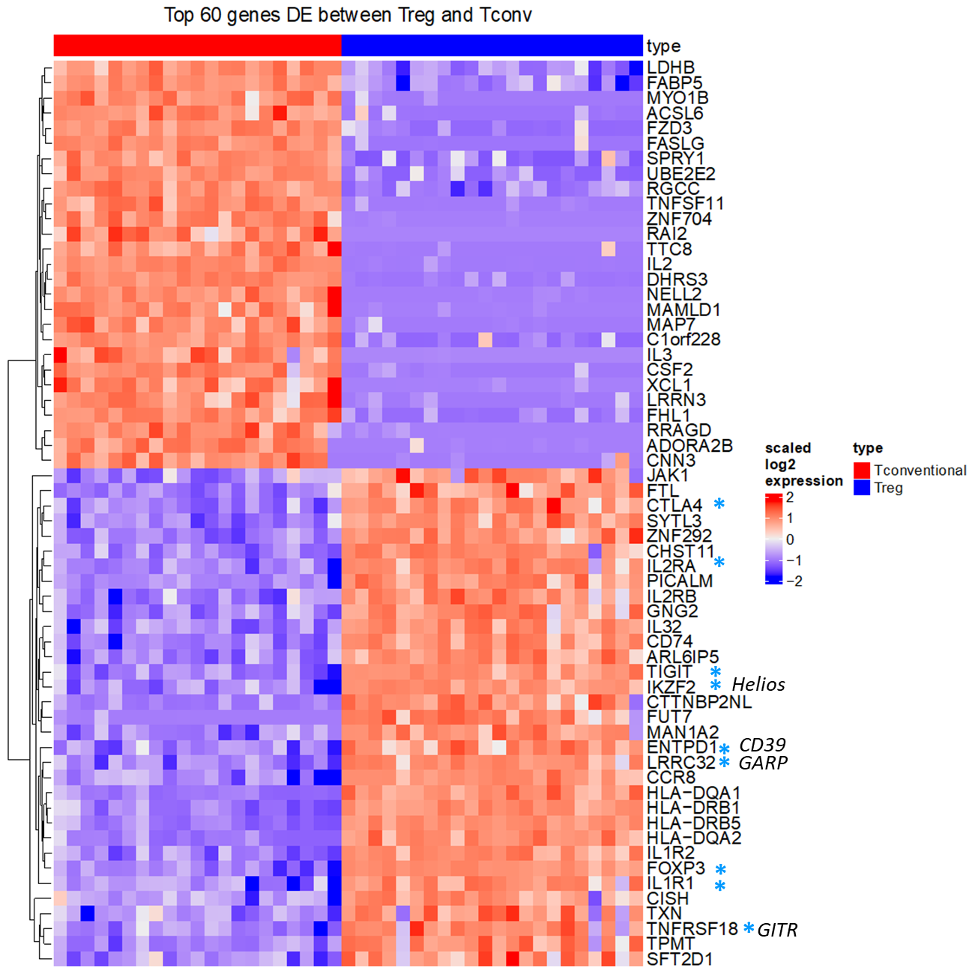
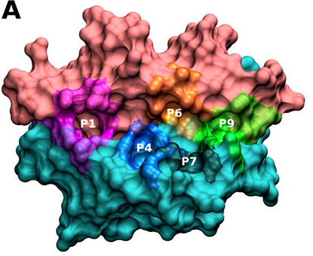
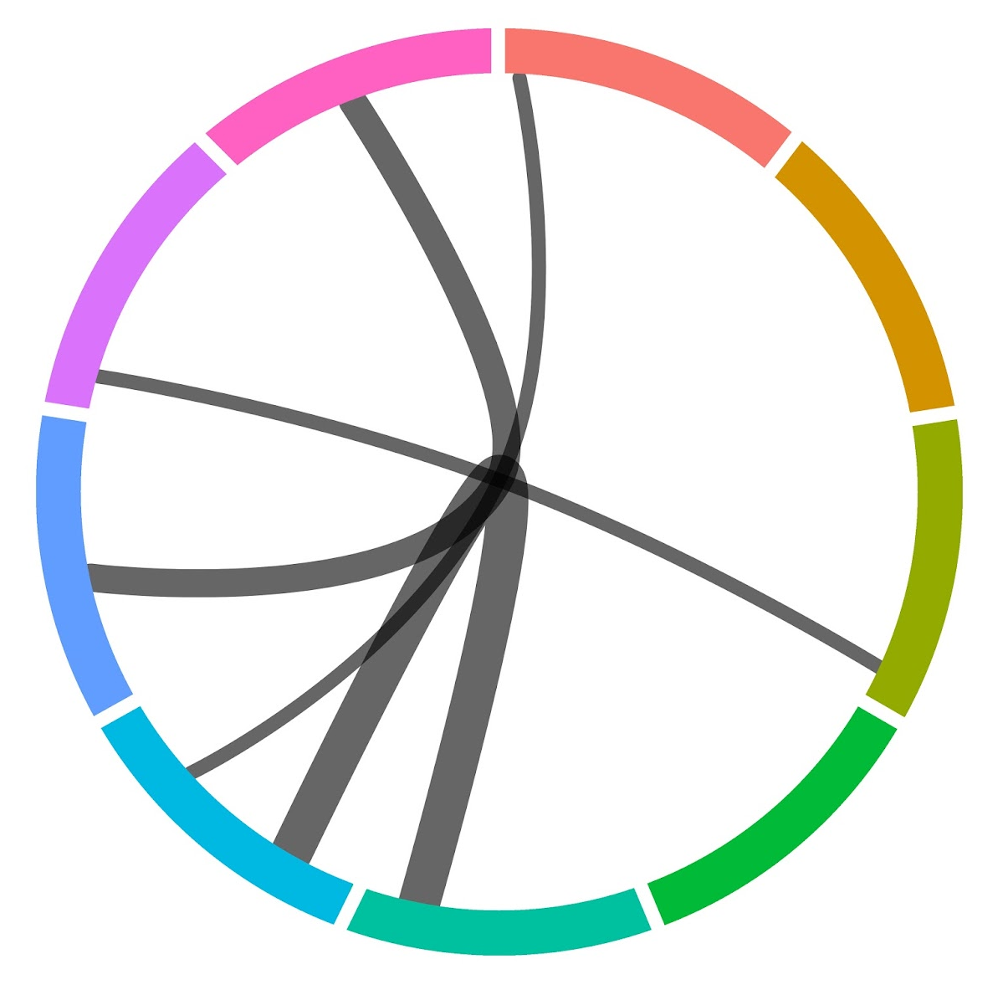
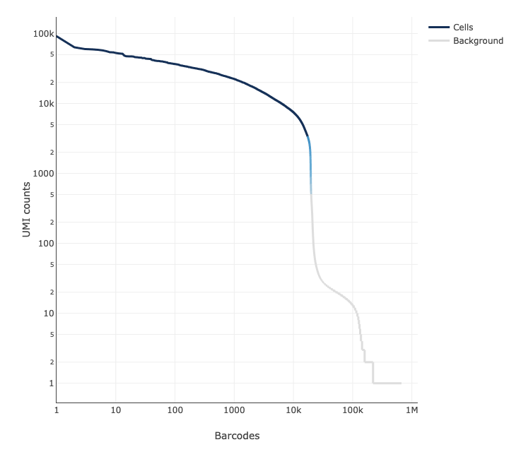
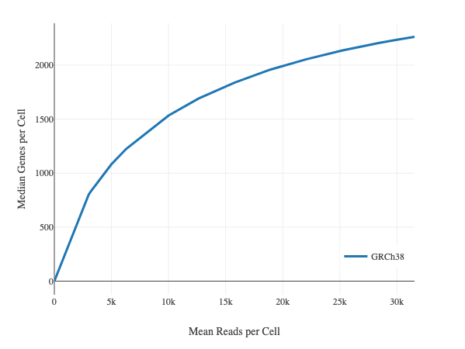
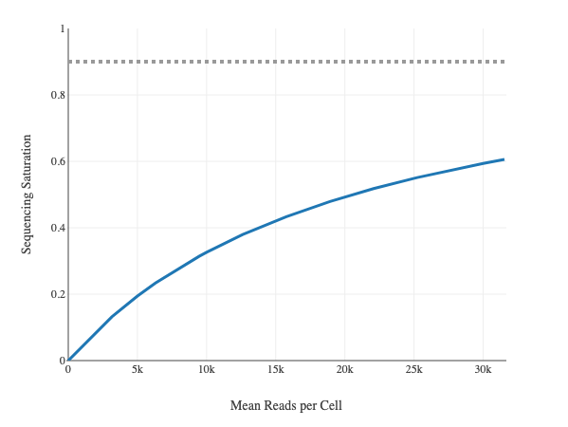

Foreign and autoreactive cd4 conventional and regulatory t cells in t1d and healthy subjects
Thomas H. Edwards^{2*}, Janice Chen^{1*}, Alex Hu², Vivian Gersuk², David J. Rawlings³, Jane Buckner¹, Karen Cerosaletti¹
Centers for ¹Translational and ²Systems Immunology, Benaroya Research Institute, Seattle WA;
³Seattle Children Research Institute; *Co-1st authors
Summary
2. scRNAseq processing
Objective:
Characterize the features of islet autoreactive CD4 regulatory T cells (Tregs) in type 1 diabetes (T1D) compared to islet CD4 conventional T cells (Tconv) in the context of foreign antigen-reactive T cells.
Approach:
Peripheral whole blood from cross sectional cohorts of established T1D subjects and matched non-diabetic healthy controls carrying the high-risk class II DRB1*0401 allele.
Isolated islet and foreign reactive CD4 Treg and Tconv cells using a CD154-CD137 activation induced marker (AIM) assay by single cell sorting followed by single cell RNA-sequencing utilizing 10X Chromium 5’ GEX/TCR/FB with Illumina P4 XLEAP.
Analyzed the transcriptomic and TCR profiles of foreign and islet reactive CD4 Tregs and Tconv cells in T1D donors compared with control donors.
Results:
Multiple samples can be prepared in one day, hashtagged, and combined
10X cell capture was poor, 35%, but chip was loaded on high end (50K)
We were able to test multiple stimulations
Polyclonal stimulated CD4 works well as a landscape of all CD4 T cells as they co-cluster with AIM stimulated cells
Ag specific but not polyclonal stimulated T cells show clonal expansion
Little TCR sharing between Tconv and Treg cells
Conclusion:
Islet autoreactive CD4 Tregs and Tconvs display TCR repertoires similar to those of foreign reactive CD4 Tregs and Tconvs
1. Optimize RNA clusters with consensus of unsupervised metrics
Davies-Bouldin Index
Maximize pairwise inter-cluster distances and minimize intra-cluster variances
Calinksi-Harabasz Index
Maximize inter-cluster variance and minimize intra-cluster variances.
Median Silhouette Score
Minimize intra-cluster distances and maximize distances to nearest cluster.
2. Optimize 2D UMAP embedding with scDEED
Cells should have the same neighbors in 2D and ND
UMAP embedding trustworthiness
3
5
2
Approach
1
4
UMAP 2
A. Study donors
6
0
Group | No. subjects | M:F | Age (median, range) | Disease duration (median, range) | HLA class II
T1D | 3 | 1 : 2 | 33 y (24-43) | 14.4 y (13.4-32.7) | DRB1*0401
Control | 3 | 2 : 1 | 28 y (25-72) | -- | DRB1*0401
UMAP 1
B. Single cell sequencing pipeline
Xia, L., Lee, C. & Li, J.J. Statistical method scDEED for detecting dubious 2D single-cell embeddings and optimizing t-SNE and UMAP hyperparameters. Nat Commun 15, 1753 (2024). https://doi.org/10.1038/s41467-024-45891-y
3. scRNAseq results
3
5
2
3
5
2
3
5
2
1
4
1
4
1
4
6
0
6
0
6
0
All clusters have all donors and both studygroups
Most clusters contain appreciable cells of all specificities except 0, which is almost all microbial (foreign antigen-reactive).
IAR T cells present in every cluster.
Polyclonal Ab creates a suitable background landscape.
Clusters 6 and 3 are dominated by a few control donors.
4. Identification of regulatory and conventional Ag-specific T cells
A. Regulatory and conventional T cells are distinct in transcriptomic data
C. Single cell analysis scheme
Cell calling
-FB ‘gating’
-RNA signature
-CellTypist
Treg + Tconv characterization
-TCR repertoires
-DGE
Previously-identified Treg/Tconv signatures
P390
Hashtag demultiplexing
TCR accounting
scRNAseq processing
3
5
2
3
5
2
3
5
2
UMAP 2
1
4
1
4
1
4
6
0
6
0
6
0
UMAP 1
1. New sequencing technology successfully applied to AIM assay
UMAP 2
3
5
2
3
5
2
3
5
2
A. Cell Ranger QC
1
4
1
4
1
4
8,117 Median UMI counts/cell
Alex Hu
6
0
6
0
6
0
2,310 median genes/cell
Sequencing saturation
UMAP 1
UMI counts
Median genes/cell
24,244 total genes
B. Cell calling by TotalSeq (feature barcodes) and RNA signature gating
37,420 cells recovered / 106K loaded between 2 batches (35%)
Tconv
Treg
Barcodes
Mean reads/cell
Mean reads/cell
B. Hashtag Demultiplexing – good discrimination with few multiplets and negative GEMs
4 Control Polyclonal
4 Control Microbial
4 Control IAR
6 T1D IAR
4 Control IAR
5. Both islet ag-reactive and foreign ag-reactive Tregs/Tconvs are expanded, but share few TCR sequences
2 T1D Polyclonal
2 T1D Microbial
2 T1D IAR
6 T1D Microbial
6 T1D Polyclonal
5 T1D IAR
5 T1D Microbial
5 T1D Polyclonal
4 Control IAR
Clone IDs with 2 or more occurrences
Multimodal cell-calling consistent with CellTypist results (not shown)
We reproduce previous islet Ag-reactive TCR repertoire findings
Foreign Ag-reactive cells appear similar to IAR cells with respect to TCRs
Polyclonal cells show minimal sharing
6 T1D Polyclonal
6 T1D Microbial
6 T1D IAR
4 Control Microbial
4 Control Polyclonal
3 Control IAR
3 Control Microbial
3 Control Polyclonal
2 T1D IAR
2 T1D Microbial
3
3
3
2 T1D Polyclonal
5
5
5
1 Control IAR
2
2
2
1 Control Microbial
Cells identified per hashtag
1 Control Polyclonal
1
4
1
4
1
4
 | Microbial | IAR | Polyclonal
1_Control | 1422 | 112 | 42
2_T1D | 1869 | 153 | 160
3_Control | 3085 | 238 | 493
4_Control | 1327 | 386 | 602
5_T1D | 8342 | 240 | 275
6_T1D | 12384 | 244 | 436
C. TCR Recovery ~80%
6
0
6
0
6
0
Microbial cells downsampled to 600 per donor
Acknowledgements:
BRI Center for Interventional Immunology
BRI Center for Systems Immunology
Kim Varner | Heather White | Jodie Stroud | David Lee | Kassidy Benoscek Sandra Lord MD | Cate Speake PhD
Kimberly O’Brien | Quynh-Anh Nguyen Jeffry Yaplee | Vivian Gersuk PhD | Hannah DeBerg | Alex Hu | Stephan Pribitzer | Matt Dufort | Matt Lawrence

